Slide 1
Business Decision Modeling
Part 2

Slide 2
Topics
Recording Macros
Spreadsheet Engineering
Sensitivity Analysis
Entering scenarios
One-way tables
Two-way tables
Tornado charts

Slide 3
Recording Macros (section 4.8)
Go to Developer tab
File > Options > Customize Ribbon
Check “Developer” box
Press “Record Macro”
Assign a shortcut letter to the macro
Press “Stop Recording” when done
Editing a macro: Click on “Macros” under “Developer” tab

Slide 4
Macros (cont’d)
“Use relative references”
See “Excel Shortcuts for moving and selecting”
Can assign buttons to macros (section 4.3)
Developer > Controls > Insert > Form Controls > Button

Slide 5
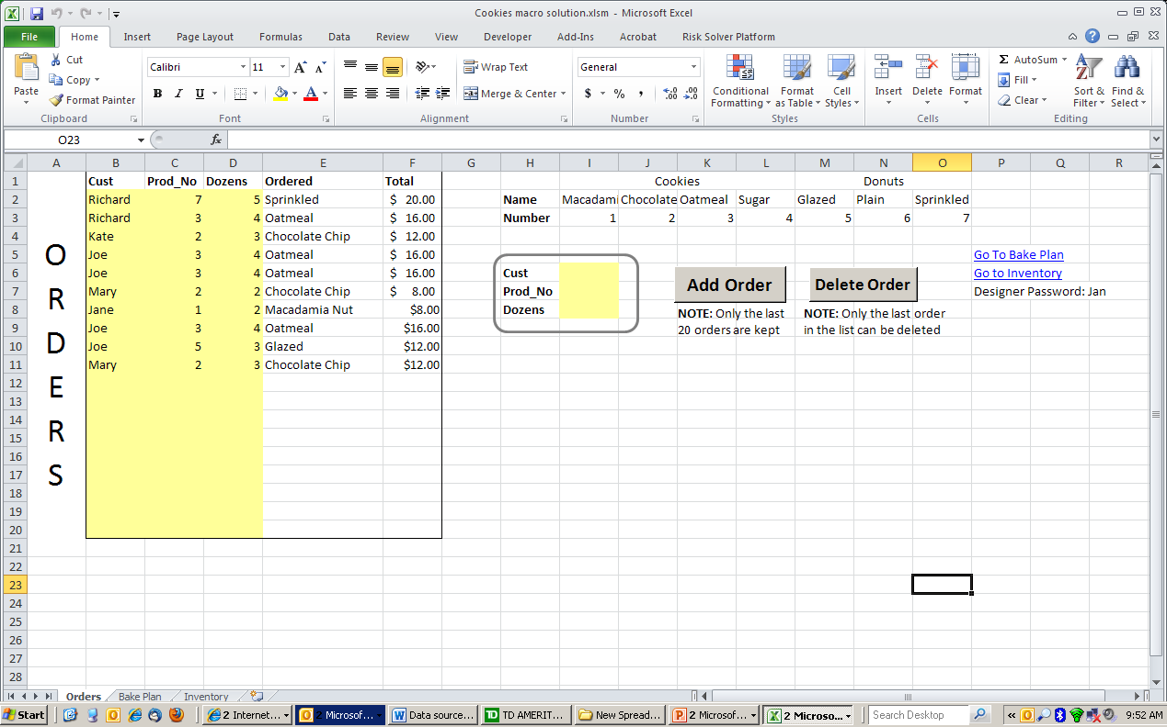
Desired Result

Slide 6
Modularize
Group like items and separate unlike items.
Separate
Decision variables
Outcome measures
Data and/or Parameters
Detailed calculations
Influence diagrams can aid with this design.
Formulas should generally reference cells above and to the left, except for the outcome measures.

Slide 7
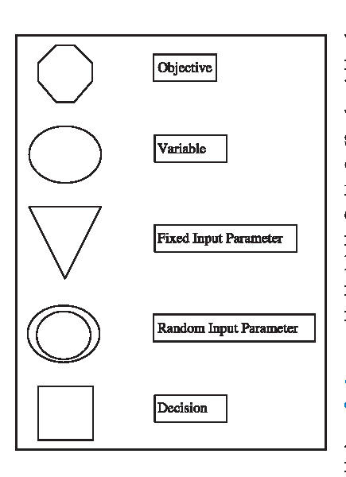
Influence Chart: notation

Slide 8
Start Small
Sketch full design but do not build all at once.
Isolate one module then build and test that module.
Local mistakes are much easier to detect than when they are part of the global model.

Slide 9
Parameterize
Place parameters in a single location away from calculations.
Formulas should only contain cell references, not numerical values for the parameters.
Assists in:
Identifying parameters
Sensitivity analysis
Documentation

Slide 10
Design for Use
Anticipate who will use spreadsheet
What type of questions will be asked?
Make it easy to change common parameters.
Make it easy to find key outputs.
Group in one place
Include graphs of outputs (dashboards).
Record numerical values of base case outputs.

Slide 11
Keep It Simple
Complex spreadsheets:
Require more time and effort to build
Are much more difficult to debug
Keep formulas short.
Decompose complex calculations into intermediate steps.

Slide 12
Design for Communication
Spreadsheets’ lives are often longer than expected.
Use visual cues that reinforce model’s logic
Use informative labels
Use blank spaces
Use outlines, color, bold fonts, as appropriate
Split windows can aid in viewing.

Slide 13
Document Important Data and Formulas
Record source for important parameters.
Explain important formulas.
Use Cell Comments to describe cell contents.
Consider a separate module to list assumptions.

Slide 14
Cell Comments
Review > New Comment to add documentation to a cell
File > Options > Advanced gives different display options
Comment & indicator – permanently display comment
Indicator – red triangle indicates comment, display when cursor in cell
None – neither comment nor indicator visible

Slide 15
Workbook Design
Use separate sheets to group similar kinds of information.
Design workbooks for ease of navigation.
Protect workbooks from unwanted changes during use.

Slide 16
Spreadsheet Engineering
Down Payment for a Mortgage ¹
You are considering buying a house for $400,000. Currently you have saved $200,000. Is it better to have a higher or lower down payment?
Here are some more details. Money not spent for the down payment will be invested with an annual return of 5%. The mortgage you are considering is a fixed rate loan of 6% for a duration of 20 years. Interest paid on the mortgage is tax deductible, but the annual interest on your investment is taxed at the same rate. You are currently in the 28% tax bracket. Tax savings from the interest on the mortgage will be added to your existing investment at the same rate. You expect inflation to be around 2% for the next 20 years.
¹ This example is meant as a classroom exercise in building spreadsheets and should not be relied upon for making actual investment decisions.

Slide 17
Timeline
Mortgage
Payment
Annual
Payments
Adjust (discount) for inflation
NPV
Principal
Loan
Balance
Tax Savings
On Interest
Investment
After-Tax
ROI
After-Tax
ROI
time

Slide 18
Modularize
Parameters ?
Decision Variables?
Outcomes?
Relationships/Calculations?

Slide 19
Outcomes
Monthly mortgage payments
Investment Value – Total Payments at end of the period
NPV of payments and accumulated investment

Slide 20
Parameters
House Value
Loan: interest rate, term
Return on Investment
Marginal tax rate
Inflation rate

Slide 21
Decision Variables
Down payment

Slide 22
Relationships / Calculations
Initial loan balance = house value – down payment
Loan balance at end or period t = Loan balance in (t-1) – Principal paid in period t
Annual Loan payment: Use Excel PMT function
Mortgage interest paid in time t = Loan balance @ start of t ∗ loan interest rate
Tax savings = mortgage interest ∗ tax rate
NPV of payment in period t =

Slide 23
Relationships / Calculations
Investment Value in period t = Investment Value in (t-1) + Interest – Taxes on Interest + Tax Savings from (t-1) = Inv Val[t-1] + Inv Val[t-1]∗ROI - Inv Val[t- 1]∗ROI ∗Tax Rate + Tax Savings from (t-1)
Principal Paid in t = Annual Mortgage Payment – Interest paid in period t

Slide 24
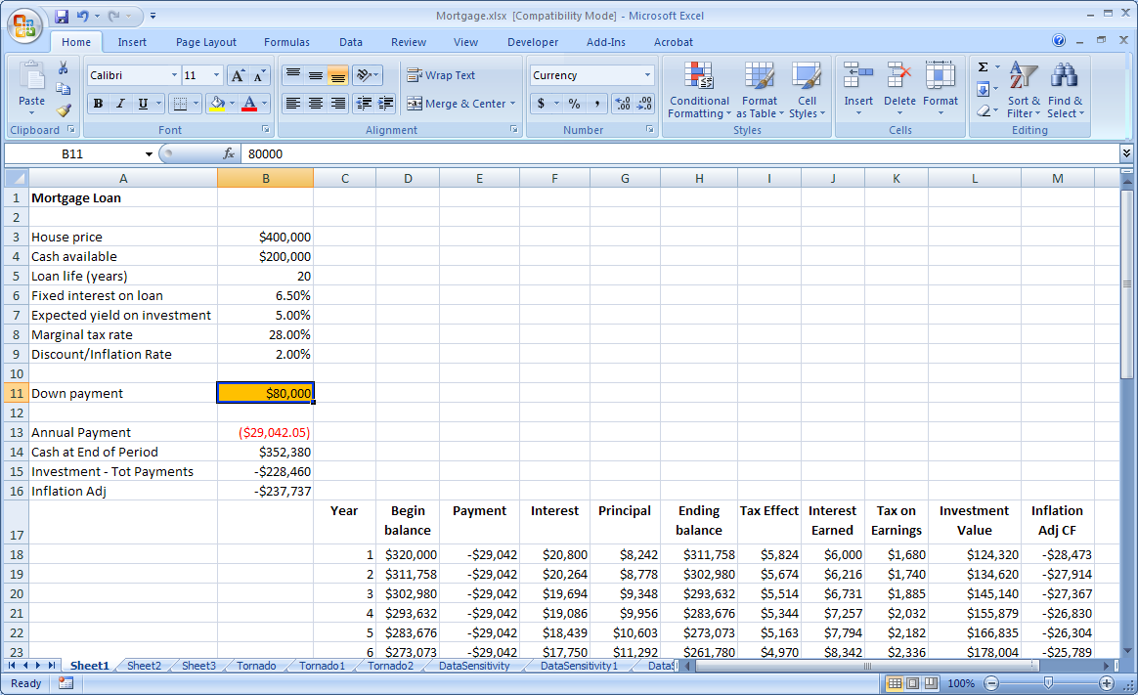
Mortgage: Spreadsheet
Parameters
Decision Variable
Outcomes
Calculations Relationships

Slide 25
Excel Functions
PMT(): computes annual mortgage payment
SUMIF(): adds contents of cells satisfying a certain condition
VLOOKUP() looks up a value in a range

Slide 26
Homework Extension (optional)
Add a new decision variable “Housing budget” which is the annual amount (in $) you set aside for housing
(Part of) the amount from the “Housing Budget” not spent on paying mortgage can be invested also
Add a new decision variable that represents the percentage of the left-over housing budget that you will invest (this was assumed to be zero before)
What percent of the left-over housing budget should be saved to break even between high and low down payment?

Slide 27
Sensitivity Analysis
How are the results of the workbook affected by changes in the parameters?
Which parameters are more important (i.e., cause bigger changes) than others?
For which values of the parameter(s) do I break even?
Tools:
Benchmarking
Scenario analysis
Parametric Sensitivity
Tornado Charts
Breakeven Analysis

Slide 28
Questions
How are the results impacted by:
Interest rate of the loan
Inflation rate
Expected ROI
Tax Rate
Down Payment
Etc.
Which of the above factors impacts the results the most?
At what inflation rate are the outcomes with and without inflation adjustment identical?

Slide 29
Tornado Charts
Measures the sensitivity of parameters defined in the model
Determines how the output changes based on changes in the inputs
Shows which parameters have a major impact on the results and which do not

Slide 30
Types of Tornado Chart
Constant Percentage
Will vary all parameters by a constant percentage entered by the user (default is 10%)
Manually enter lower and upper bound
10/90 Percentiles
If the distribution of the parameter is known, one can enter the 10th and 90th (or 5th and 95th) percentile

Slide 31
Tornado Chart: Example

Slide 32
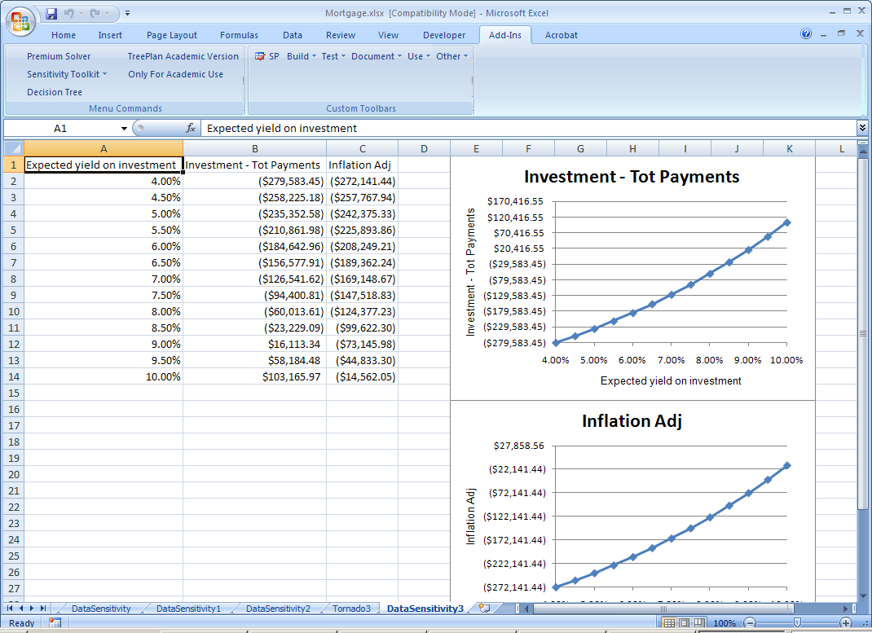
One-Way Table

Slide 33
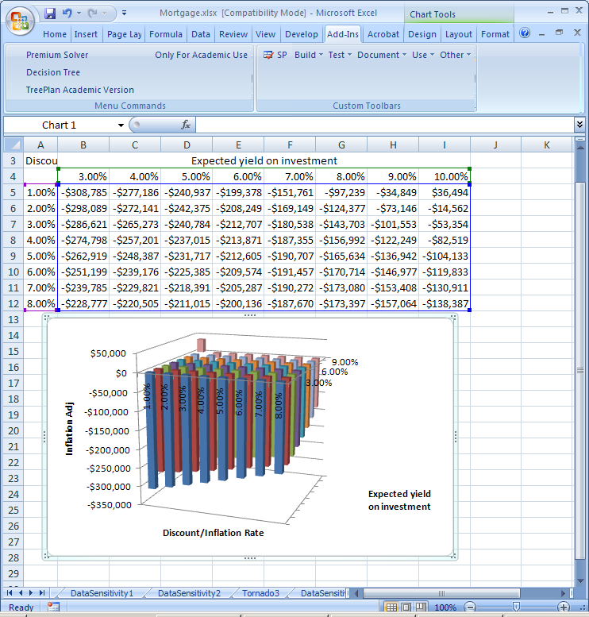
Two-Way Table

Slide 34
Goal Seek
Adjusts one cell to find the value such that the outcome equals a specified value
Is used, e.g., to find the break-even point (when profits vanish)
May depend on starting value of the parameter (try several ones)
E.g.: which is the minimum ROI needed such that the minimum down payment strategy outperforms the maximum down payment strategy?

Slide 35
Scenarios
So far only one (or at most two) parameters are varied at the same time
Sets of parameter values often go together.
A scenario is a set of parameter values that are internally consistent.
Adding scenarios
Using Excel’s Scenario Manager
Choose Tools – Scenarios
Click add to add scenarios
Click Summary: A new worksheet will be created
Using HLOOKUP or CHOOSE with parameter values inside the spreadsheet

Slide 36
Scenarios
Usually base case, best and worst case
 | Worst Case | Base Case | Best Case
ROI | 1% | 5% | 8%
Tax Rate | 35% | 28% | 21%
Inflation | 10% | 2% | 1%

Slide 37
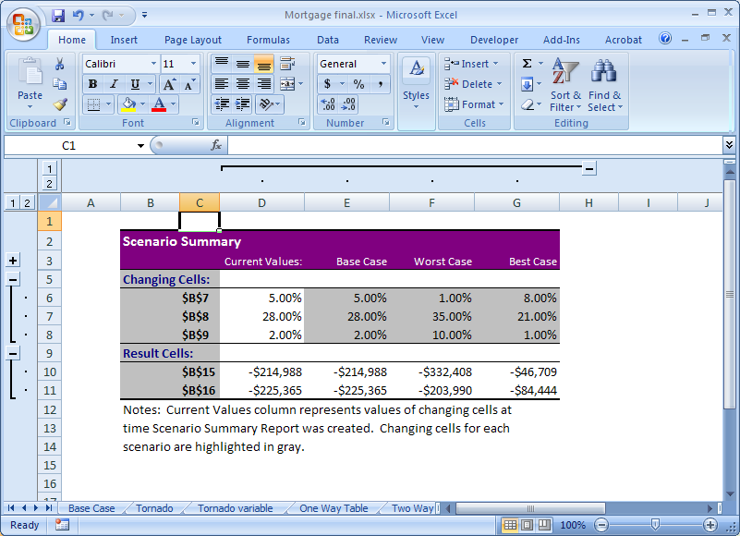
Scenario Summary

